Slide 1


Slide 2
Set Your Goal!

Slide 3

What will you do every day?
Make a PLAN!

Slide 4
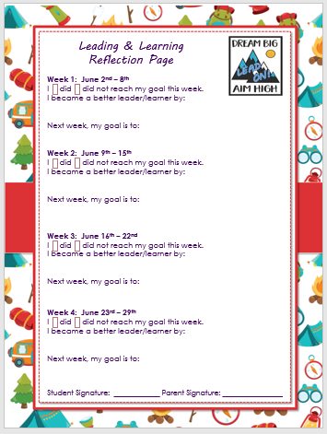
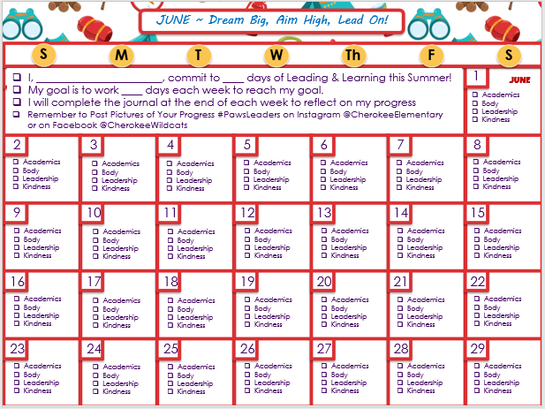
Track Your Progress

Slide 5
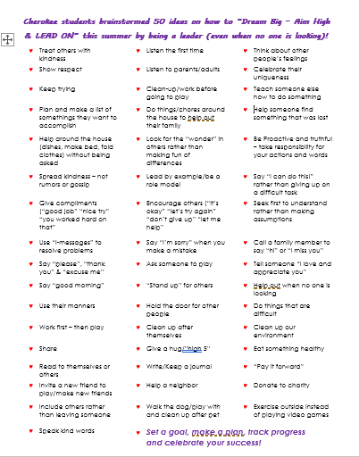
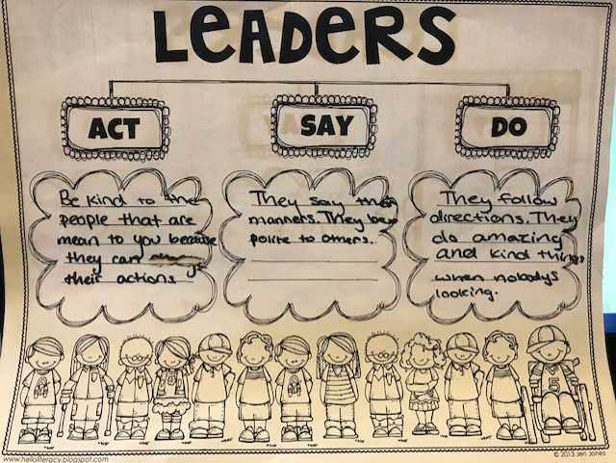
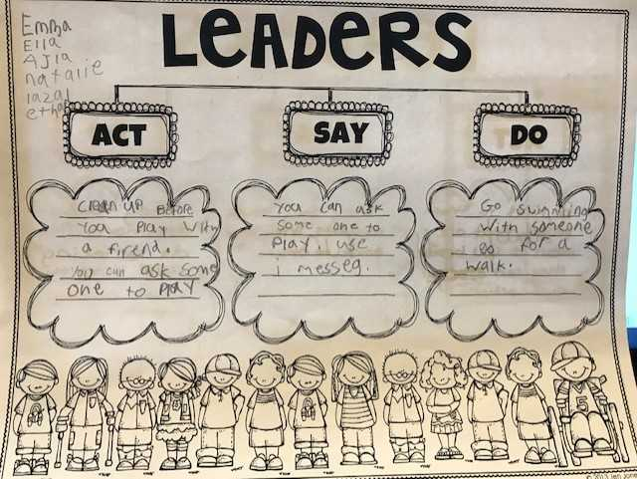

Slide 6

Track Your Progress

Slide 7
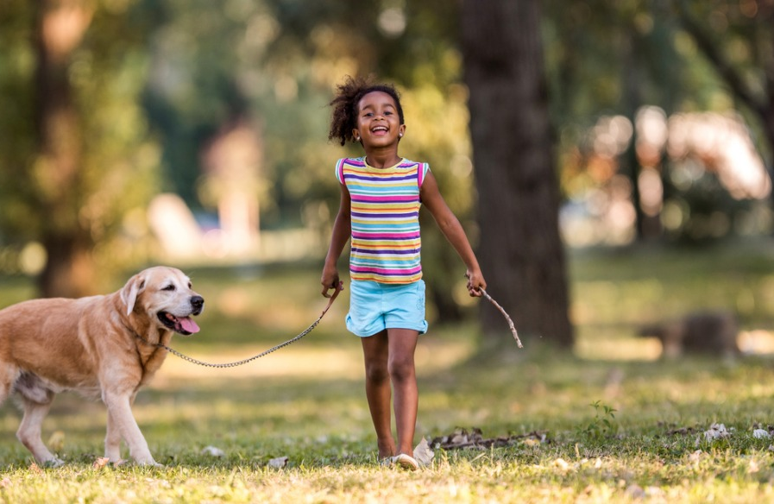
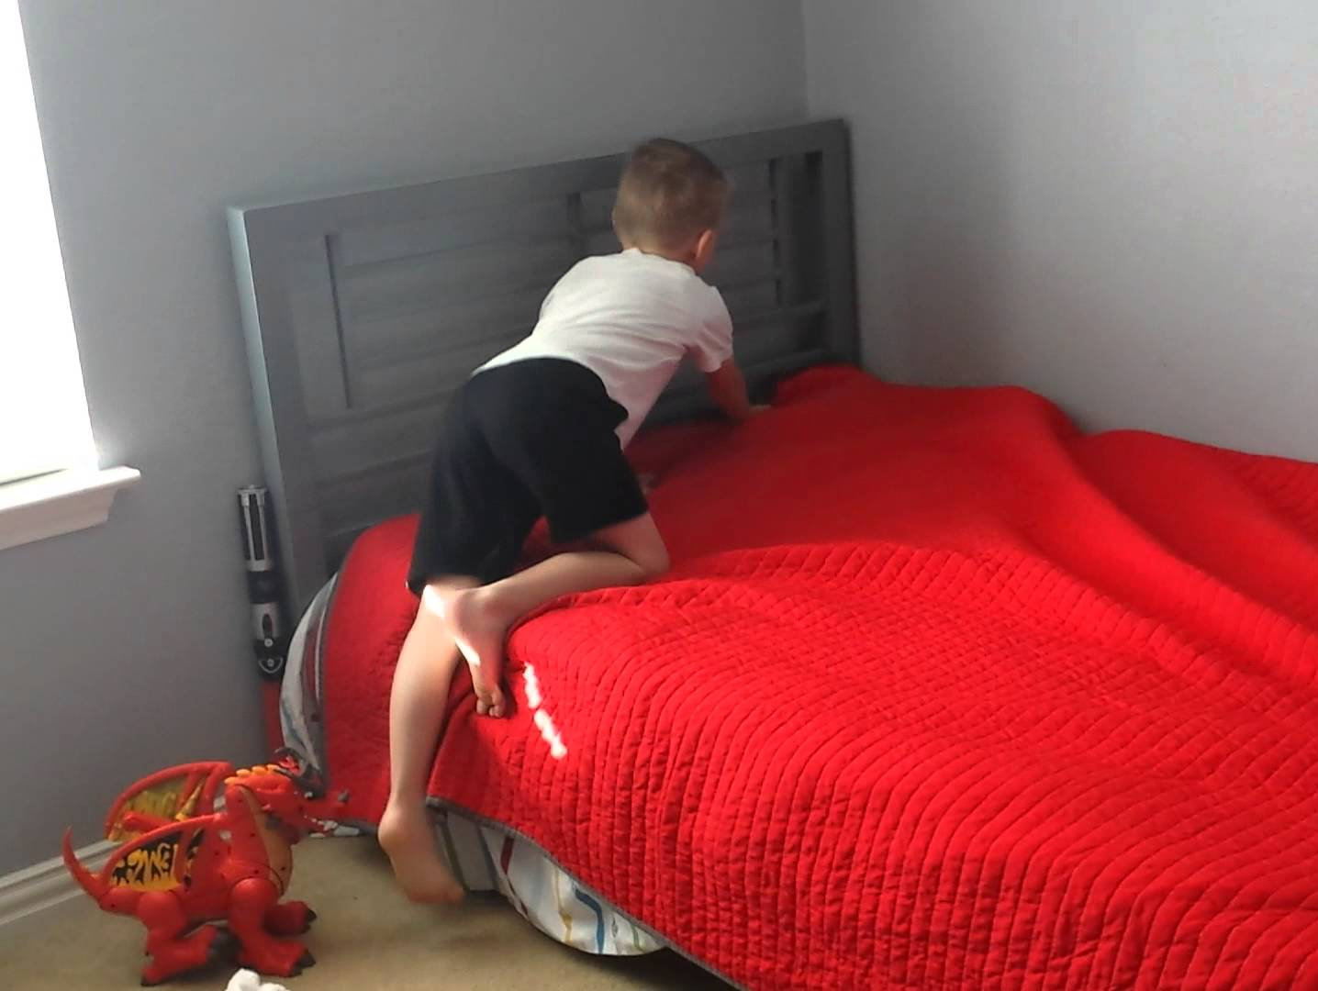
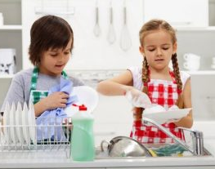
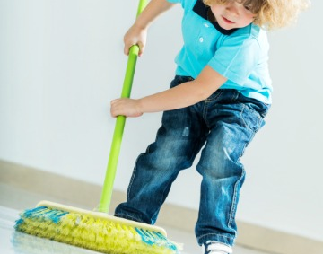

Slide 8
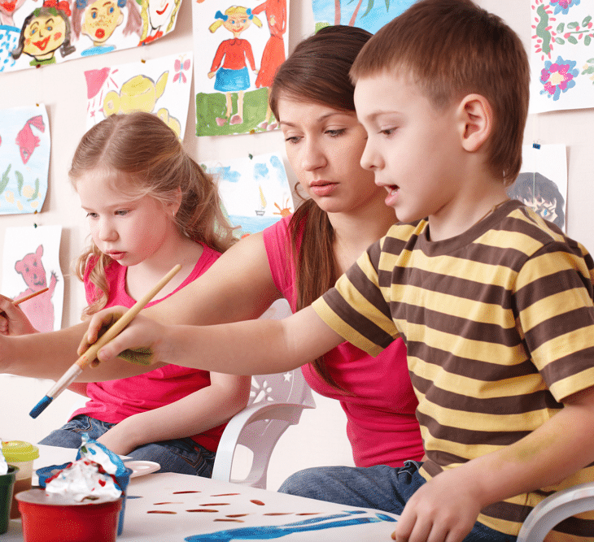

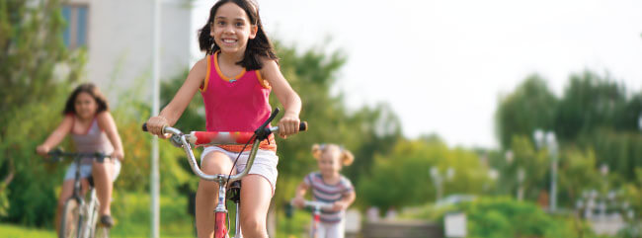

Slide 9

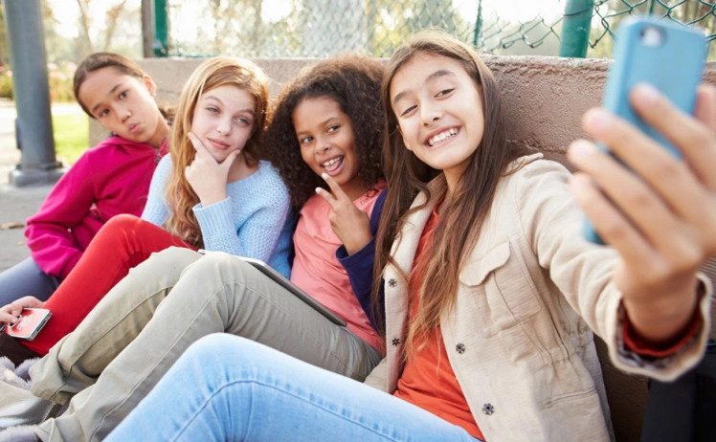

Share Your Progress
@CherokeeElementary
#PawsLeaders
@CherokeeWildcats

Slide 10
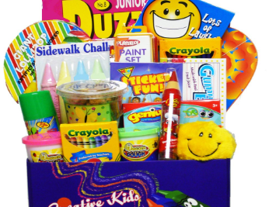
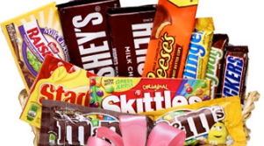
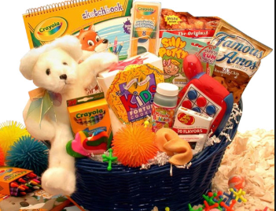
Earn a Raffle Ticket for Posting Online Every Month

Slide 11



Celebrate Success!
A Moment with
Mrs. Mair & Your Specials Teachers

Slide 12

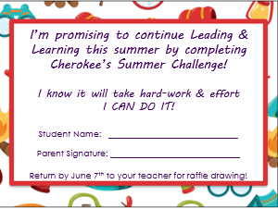

Slide 13
Earn a Raffle Ticket for Posting Making the Summer Challenge Promise!

Slide 14


Slide 15
NEW THIS YEAR

Slide 16
is a special way to raise
money for our school

Slide 17
It starts today!
TODAY
1
2
3 Months
And it goes until the end
of summer.

Slide 18
How does it work?

Slide 19

You ask people for donations…

Slide 20

We ask people for donations…
…to support you as you complete the Summer Challenge learning & leadership activities!

Slide 21
How do we
get donations?

Slide 22

You can CALL or VISIT people

Slide 23

Or use a phone or computer
to invite even more people!

Slide 24


They can use their phone or computer to donate money to our school!

Slide 25
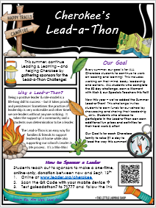
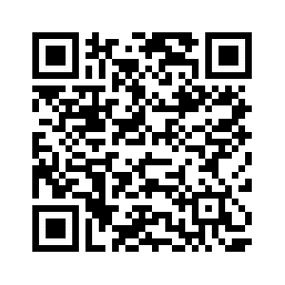
This Page Tells Families about the Lead-a-Thon
Students reach out to sponsors to make a one-time, online-only, donation between now and Sept. 13th
Online at www.leader.org/cherokee
Scan the QR Code with your mobile device →
Text goleadathon7 to 71777 and follow the link

Slide 26

Less than $1 a Day

Slide 27

Students who earns donations get prizes!

Slide 28
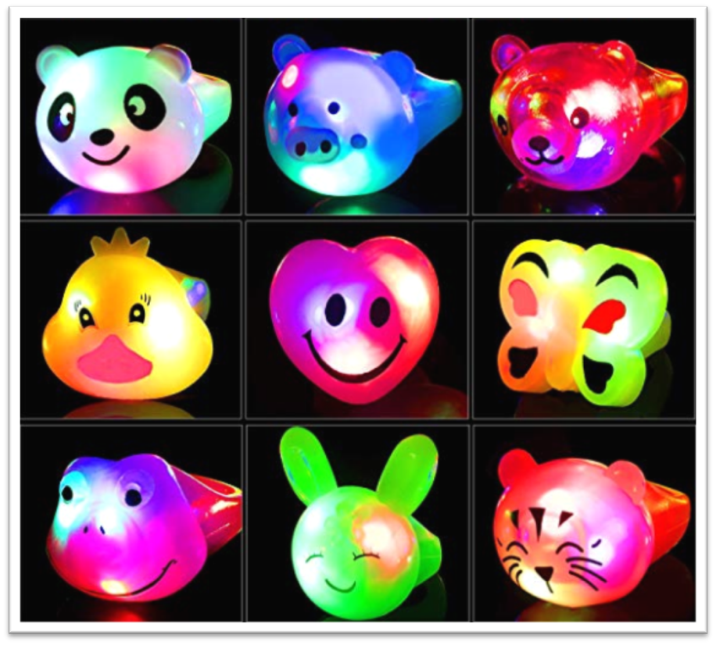
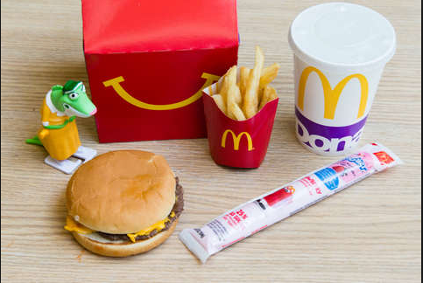



This Page Shows The Prize Levels for Earning

Slide 29
Leading & Learning this summer helps you and our school –
It’s WIN-WIN!!

